Slide 1
IBM Data Analyst Capstone Project
Analysis on Emerging Technology Skills and Trends
Oscar Hidalgo Gutiérrez
02 June 2024

Slide 2
OUTLINE
Executive Summary
Introduction
Methodology
Results
Visualization – Charts
Dashboard
Discussion
Findings & Implications
Conclusion
Appendix

Slide 3
EXECUTIVE SUMMARY
Staying ahead in the global IT market requires adapting to rapidly evolving technologies. This report leverages data analytics to shed light on current and forecasted skill demands within the realm of programming languages, databases, and additional tech domains. It also examines the demographic profiles of tech industry professionals.
Data was sourced from a Stack Overflow survey, the IBM website, and Github job listings. It underwent collection, cleansing, exploratory analysis, and was then displayed on dashboards.
The analysis reveals that JavaScript remains the most favored programming language with expectations to maintain its popularity. Currently, MySQL sees the most usage, whereas PostgreSQL is expected to experience increased demand going forward.
Moreover, the bulk of survey participants are male, based in the USA, and are typically 28 years old.

Slide 4
INTRODUCTION
This report employs data analytics to elucidate both current and forthcoming trends concerning the demand for skills in programming languages, databases, platforms, and web frameworks.
The research focused on the following questions:
What are the most sought-after programming languages currently?
Which database skills are in high demand?
Which are the leading IDEs and web frameworks?
The intended readership of this study includes IT professionals, HR managers, and anyone interested in the IT industry, aiming to understand the most vital IT skills today and their future relevance.

Slide 5
METHODOLOGY
Data was collected in a variety of formats, such as job availability for different technologies and locations, utilizing the Github jobs API in Python.
Programming language names and their associated annual salaries were extracted via web scraping from the IBM website. Additionally, a dataset from the 2019 Stack Overflow developer survey was downloaded and stored.
The data was cleaned and analyzed using Python. An exploratory data analysis (EDA) was conducted to evaluate the distribution, detect any outliers, and identify correlations between different columns within the dataset.
Visualization of the data was achieved through the creation of charts, graphs, and dashboards using Python and Cognos analytics tools. All Python analyses were performed in Jupyter Notebook within Visual Studio.

Slide 6
RESULTS

Slide 7
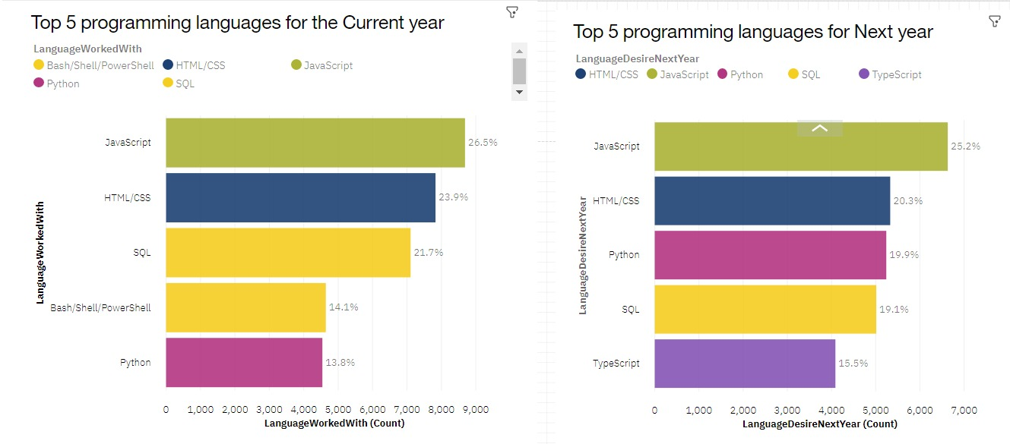
PROGRAMMING LANGUAGE TRENDS
Current year
Next year

Slide 8
PROGRAMMING LANGUAGE TRENDS FINDINGS & IMPLICATIONS
Findings
Currently, the most widely used programming languages include JavaScript, HTML/CSS, SQL, Shell languages, and Python.
For the coming years, JavaScript, HTML/CSS, Python, SQL, and TypeScript are expected to be the most prevalent languages.
Python is projected to be in higher demand than SQL next year.
Implications
The significant use of JavaScript and HTML for web development indicates a high demand for web development skills, particularly as TypeScript's popularity continues to grow.
Python is increasingly popular due to rising demands in artificial intelligence (AI) and machine learning (ML) skills.
SQL remains crucial for data professionals and is essential for those aiming to work as data analysts, scientists, or business analysts, highlighting the importance of SQL skills.

Slide 9
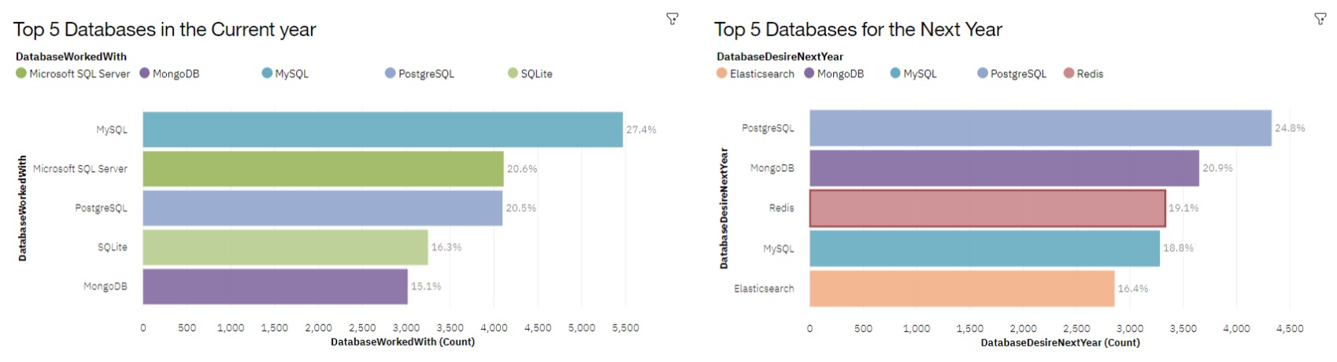
DATABASE TRENDS
Current year
Next year

Slide 10
DATABASE TRENDS FINDINGS & IMPLICATIONS
Findings
Currently, MySQL, Microsoft SQL Server, PostgreSQL, SQLite, and MongoDB rank as the top five most utilized databases.
However, PostgreSQL, MongoDB, Redis, MySQL, and Elasticsense are expected to rise in popularity in the coming years.
Redis and Elasticsense, relatively new in the market, are poised for increased traction within the IT industry.
Implications
SQL remains a critical tool for data specialists to monitor.
The preference for open-source databases continues among companies.
Oracle SQL, however, does not appear in the top five and is gradually losing its relevance.

Slide 11
DASHBOARD

Slide 12
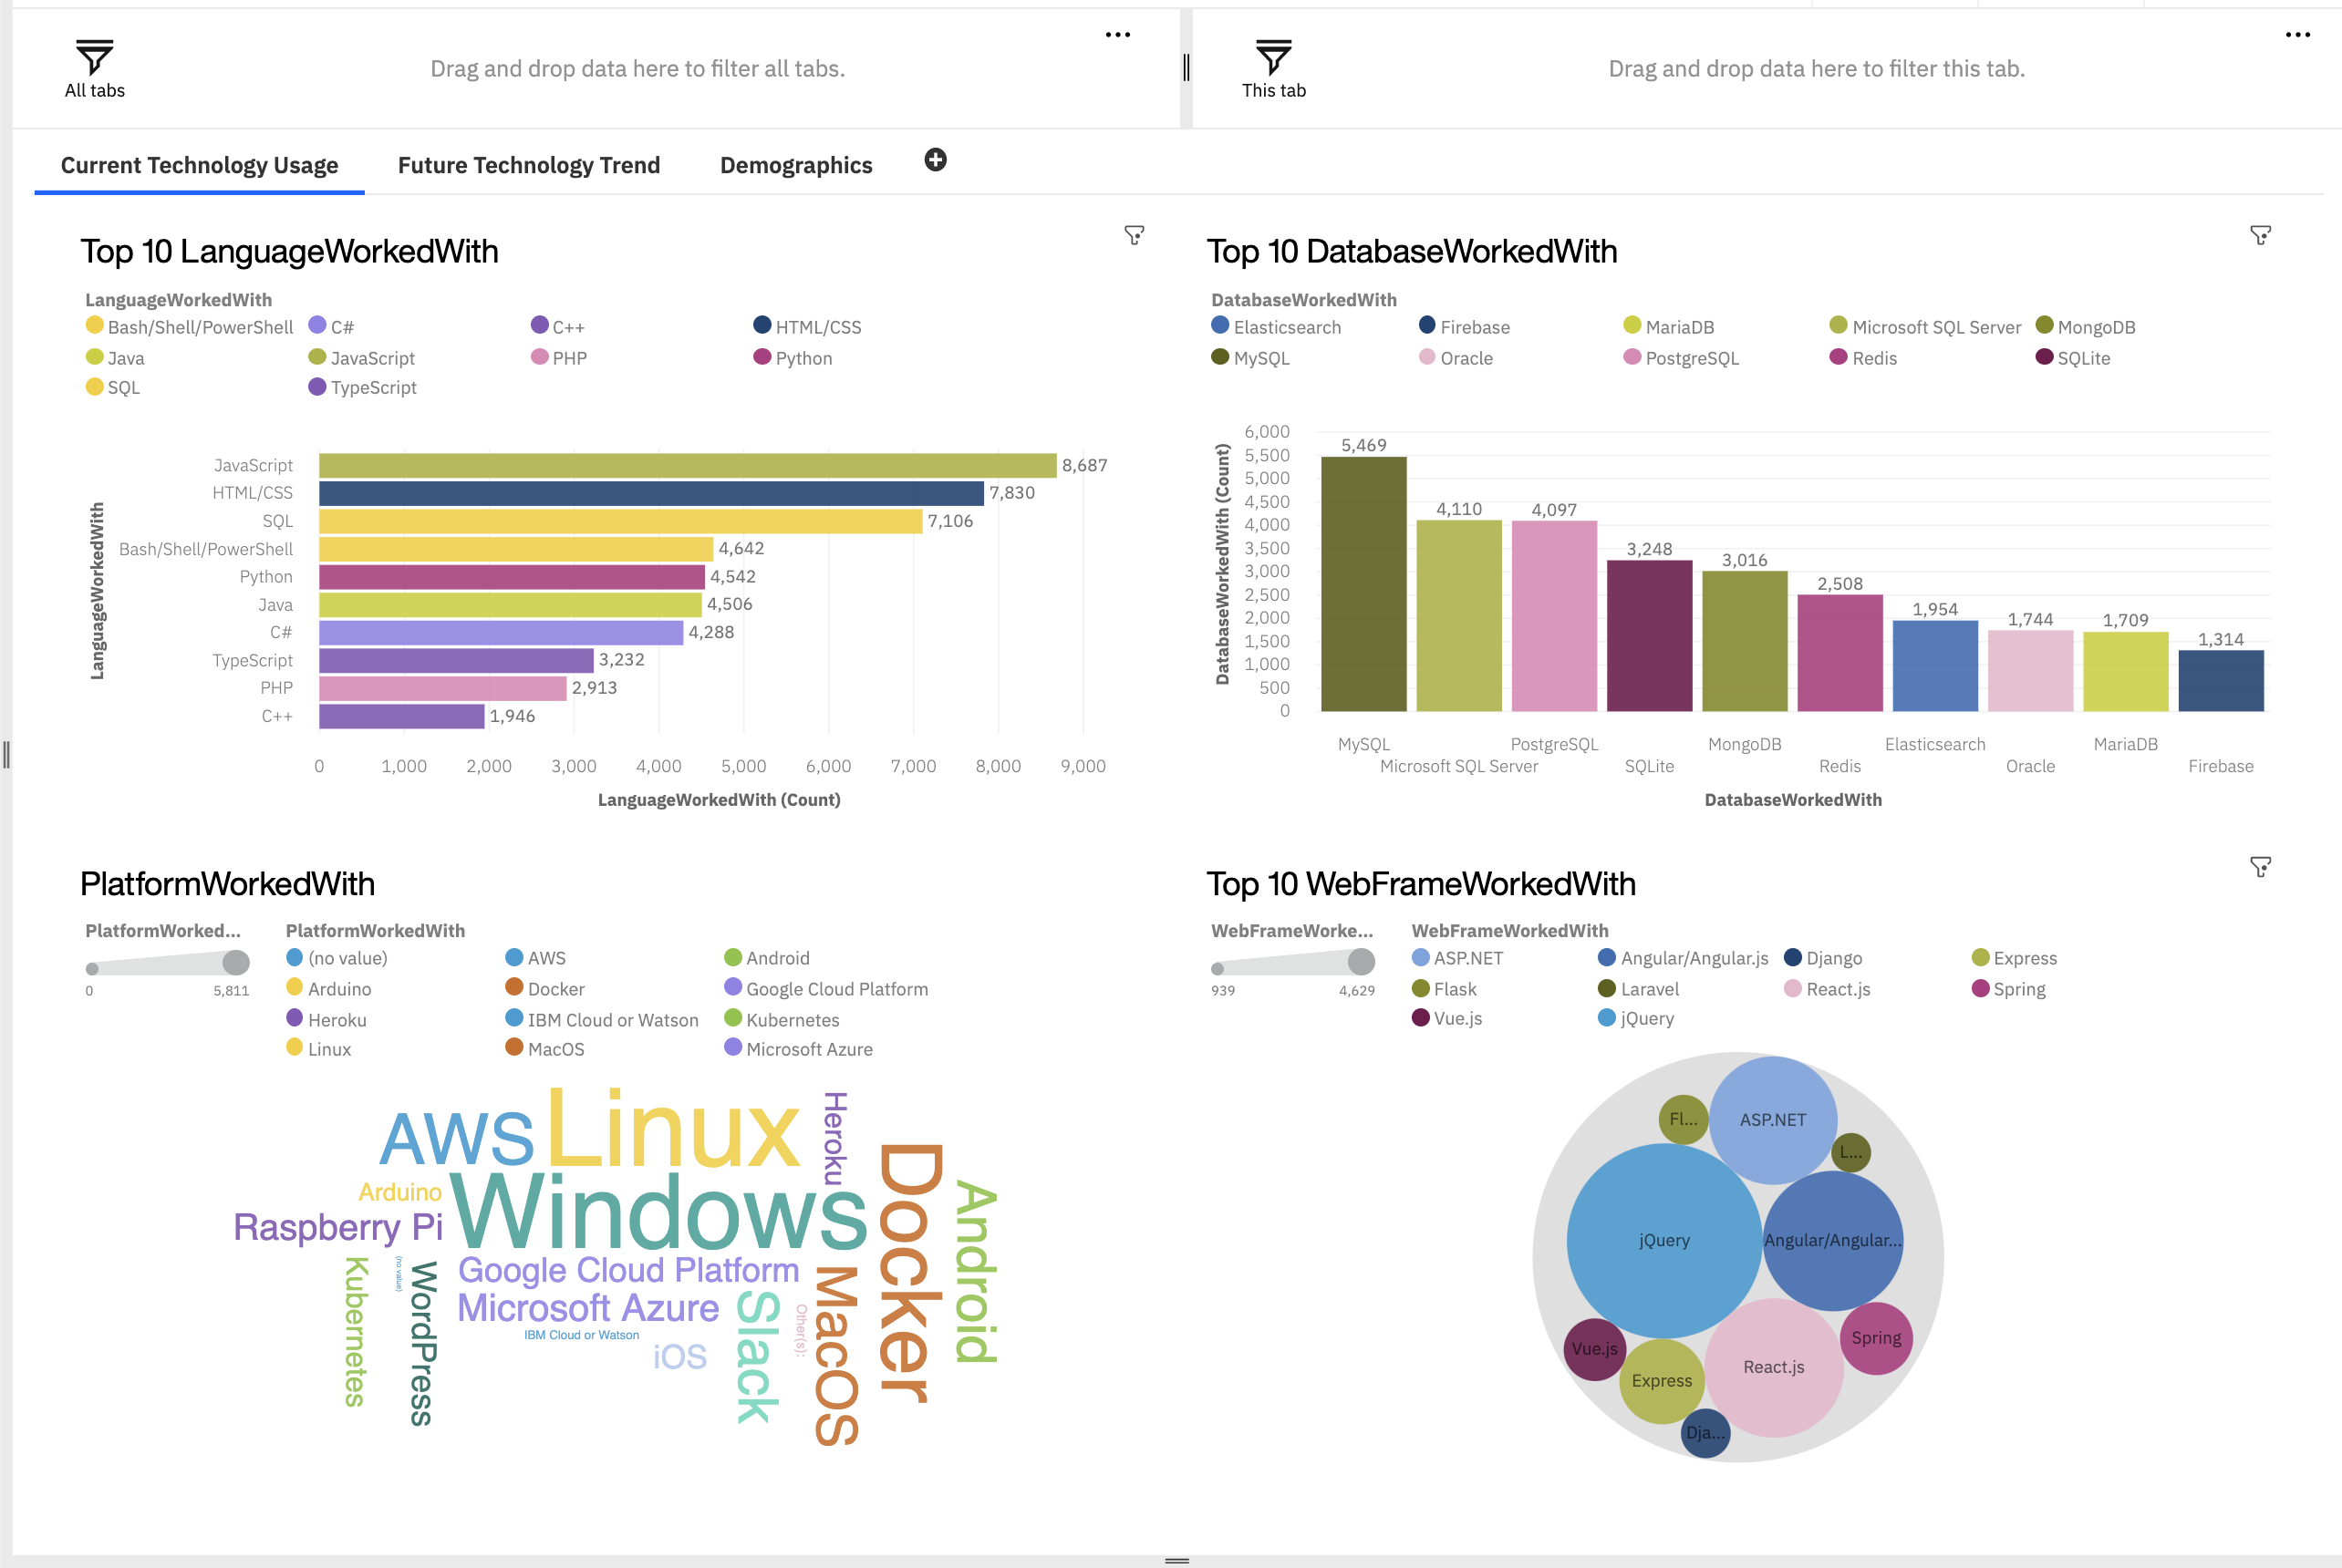
DASHBOARD TAB 1

Slide 13
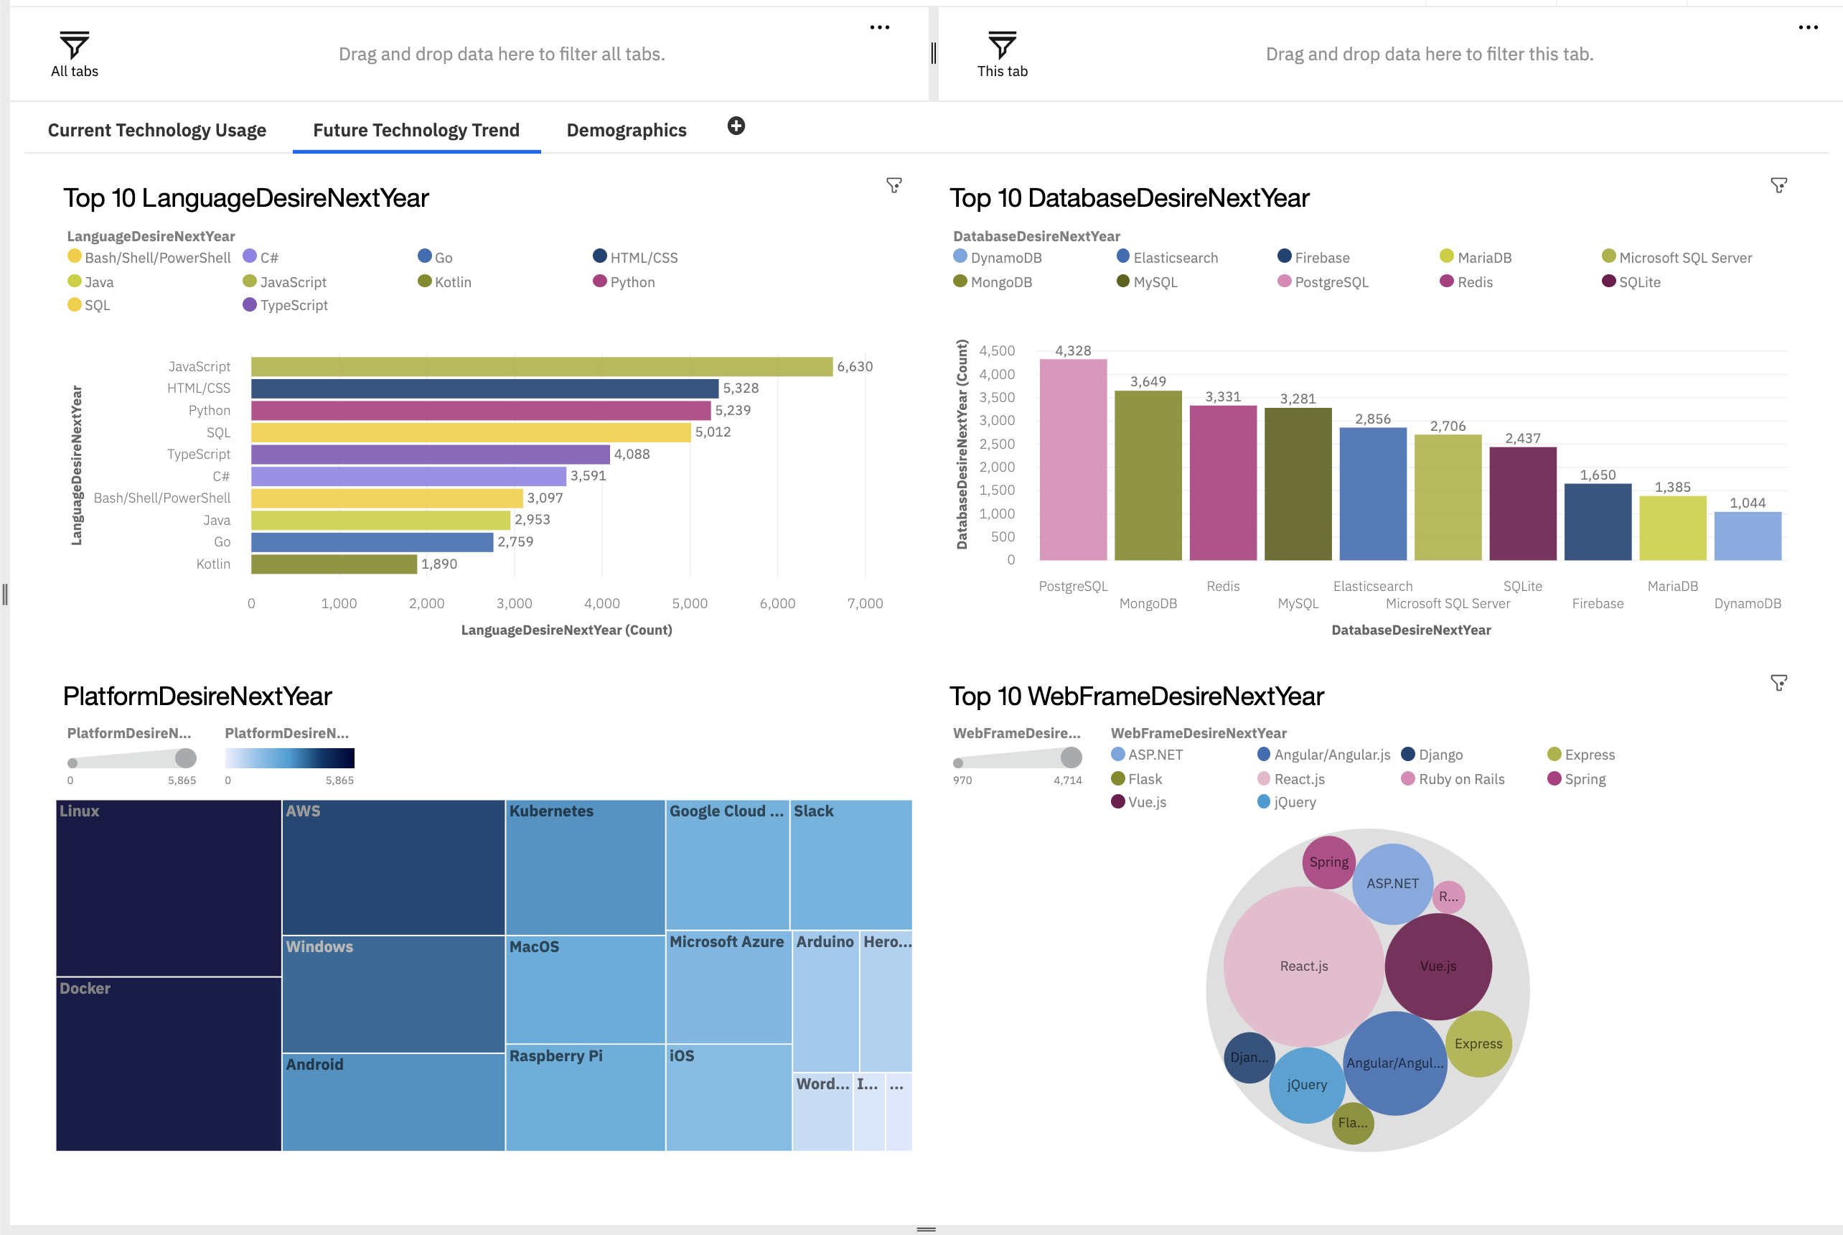
DASHBOARD TAB 2

Slide 14
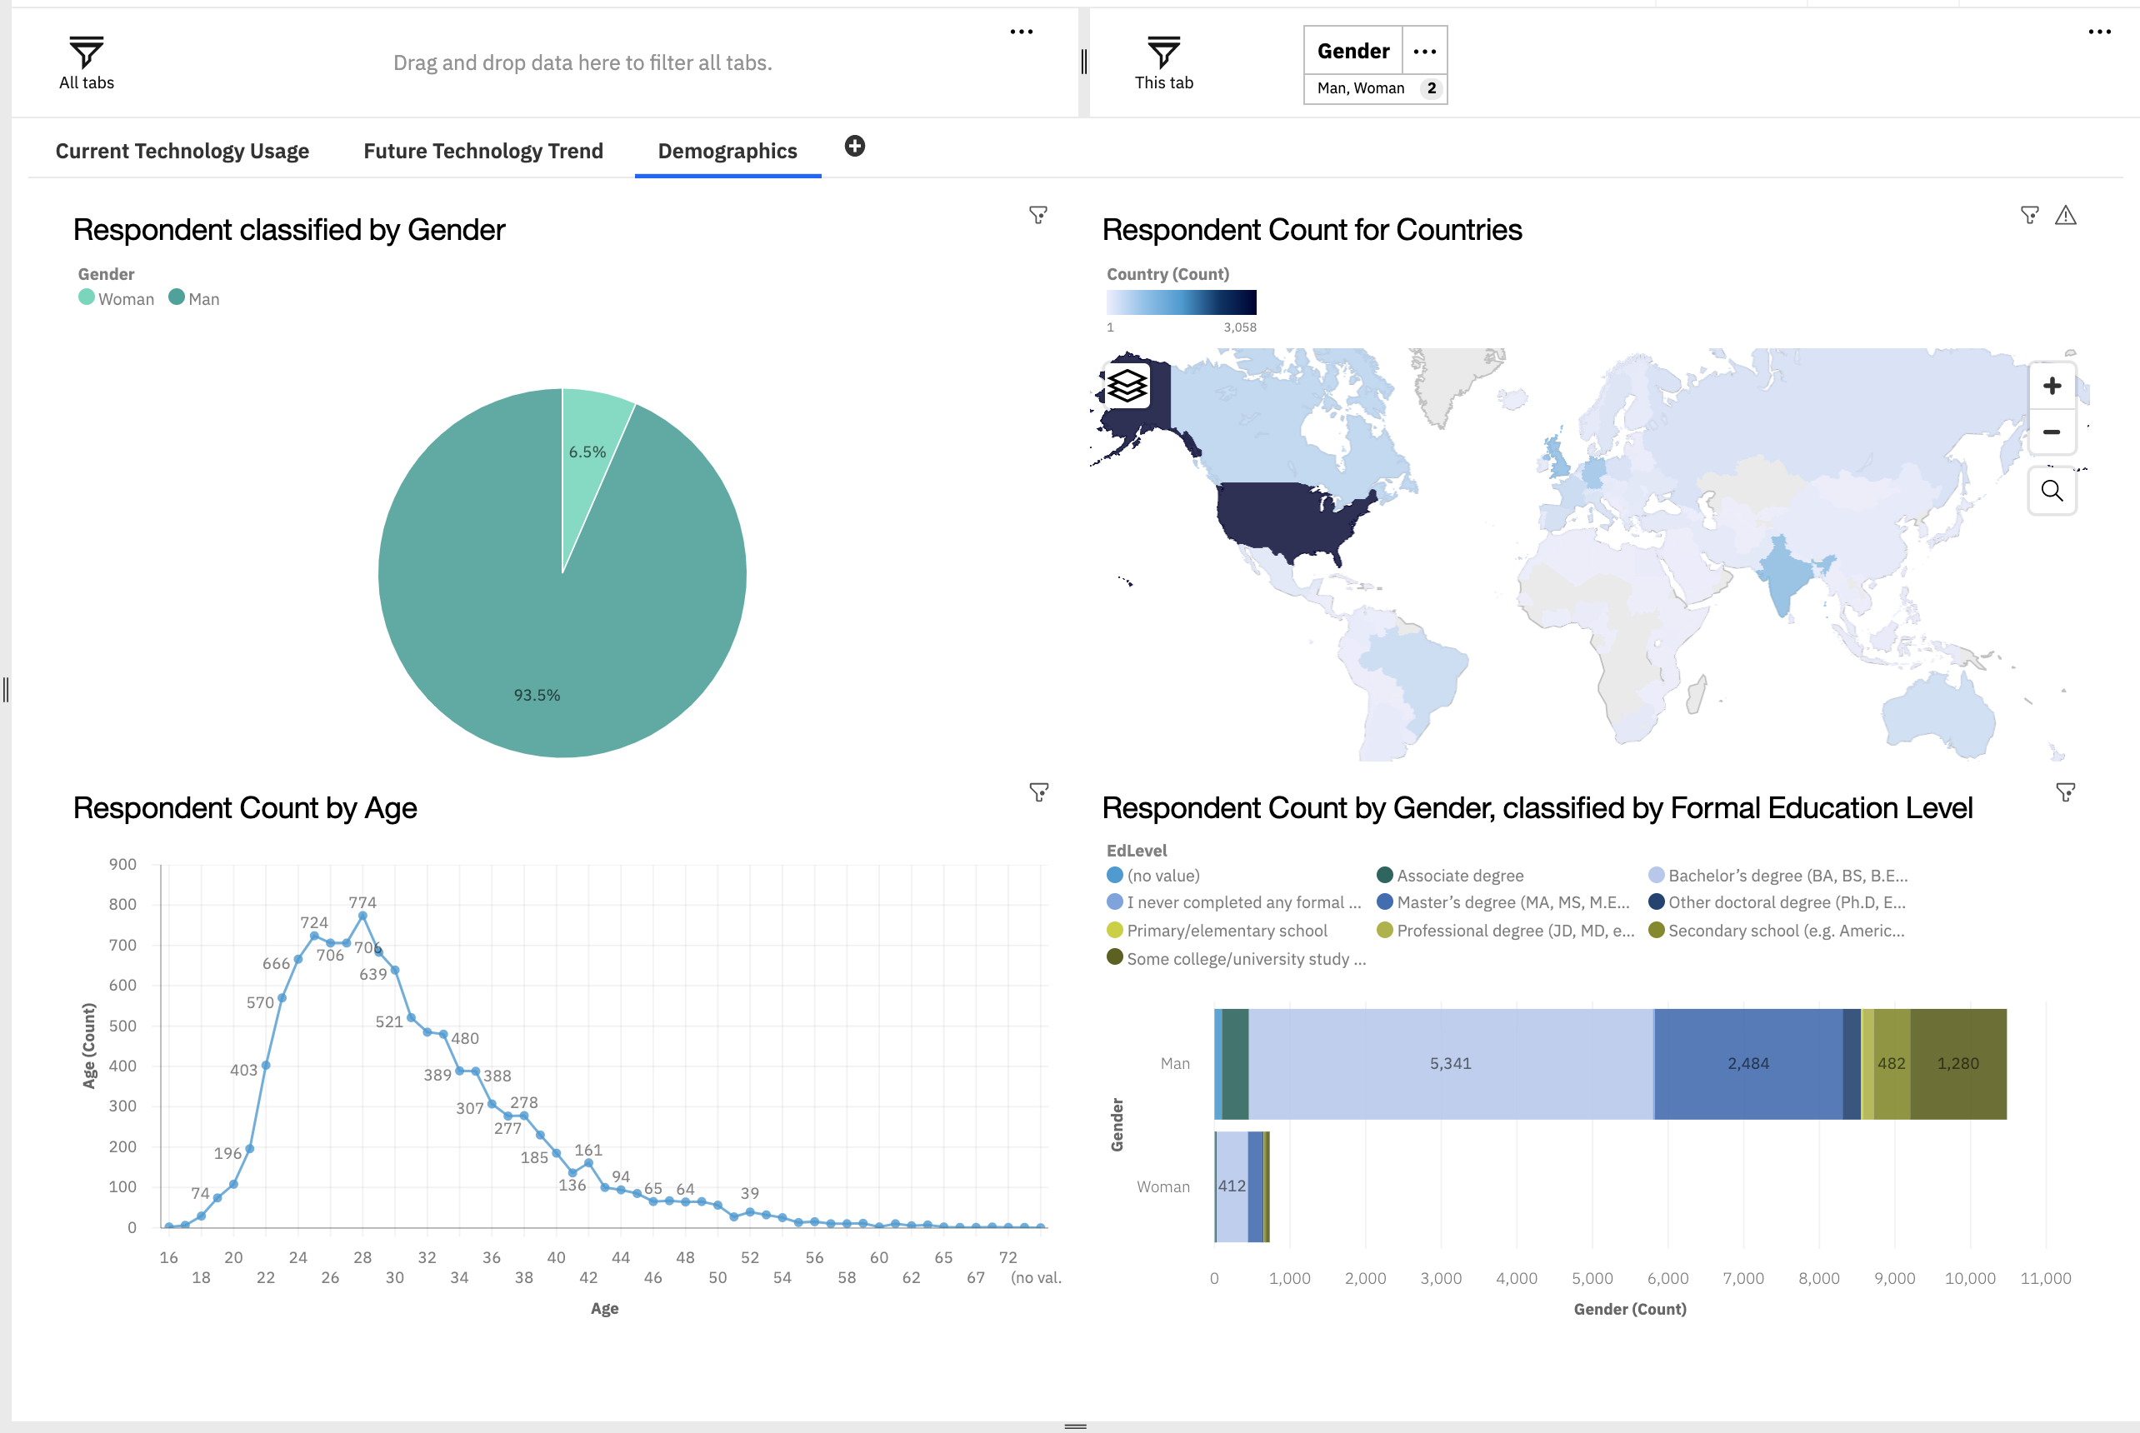
DASHBOARD TAB 2

Slide 15
DISCUSSION
Enhancing skills within the technology sector.
Strategies to narrow the significant gender disparity in technology.
Necessity of graduate or postgraduate degrees in tech careers.
Rising popularity and demand for mobile development, especially with Kotlin's growth.
Expansion of technology education and resources in less developed areas of Southeast Asia, South America, Africa, and some European regions.
Future relevance of Oracle SQL in the tech industry.

Slide 16
OVERALL FINDINGS & IMPLICATIONS
Findings
Most people in the IT field have a Bachelors' degree.
Web development languages are the most popular and on-demand tools in the IT field currently.
The Tech sector is filled with majorly young people under 40 years of age.
Most respondents want to learn Postgre SQL and React JS next year.
Implications
It is important for data professionals to develop proficiencies in NoSQL in addition to SQL databases.
Web development is still a very lucrative skill.
Less developed countries need more access to tech trainings and education.

Slide 17
CONCLUSION
It is essential to stay updated in the tech sector as trends continuously evolve. Additionally, it's crucial to close the gender gap and expand educational opportunities in less developed regions.
Assessing the necessity of advanced degrees to meet job market demands is also vital. As the demand for mobile development and skills in artificial intelligence and machine learning increases, professionals need to adapt to new tools while evaluating the ongoing relevance of established languages like SQL.

Slide 18
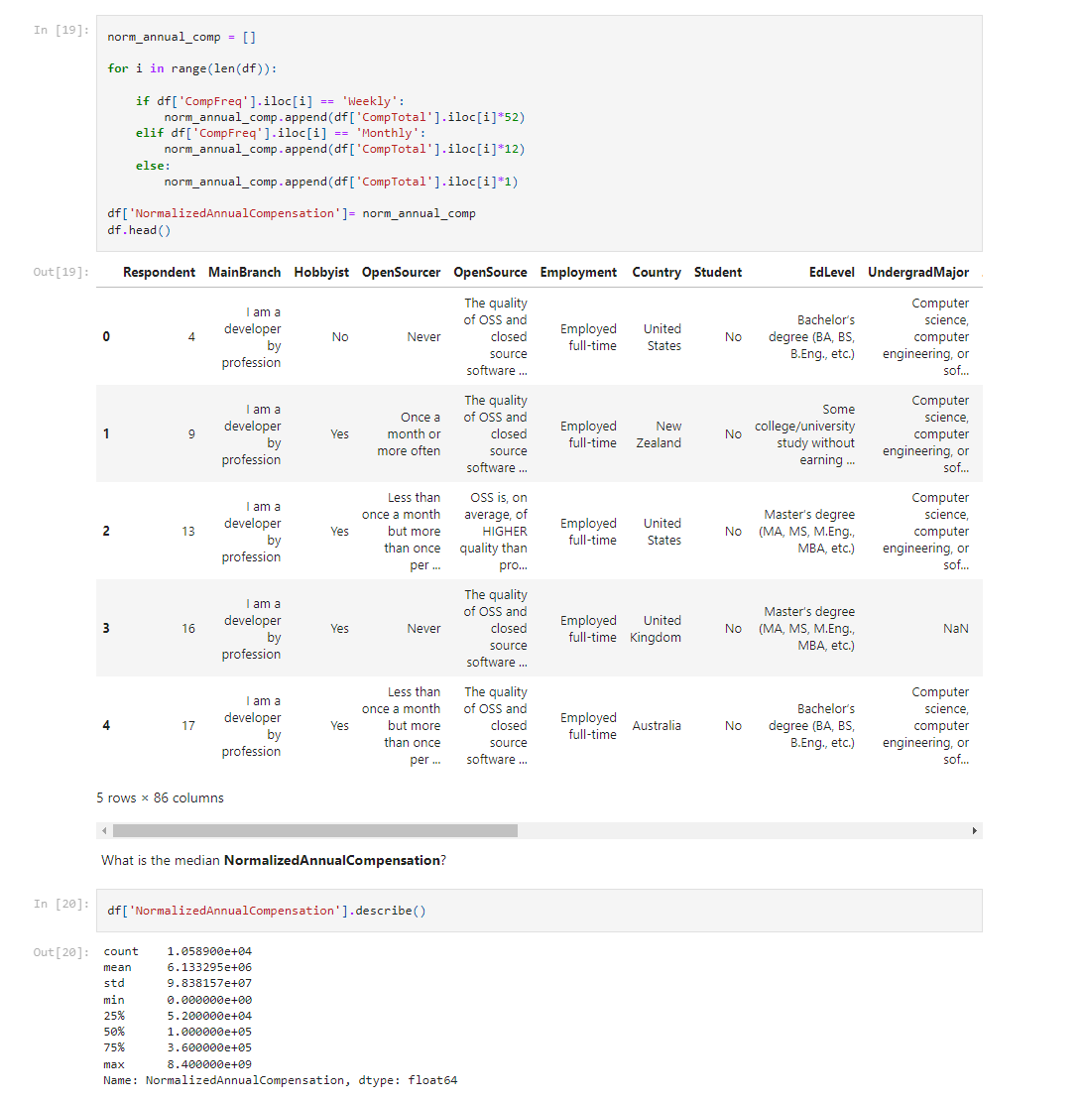
APPENDIX

Slide 19
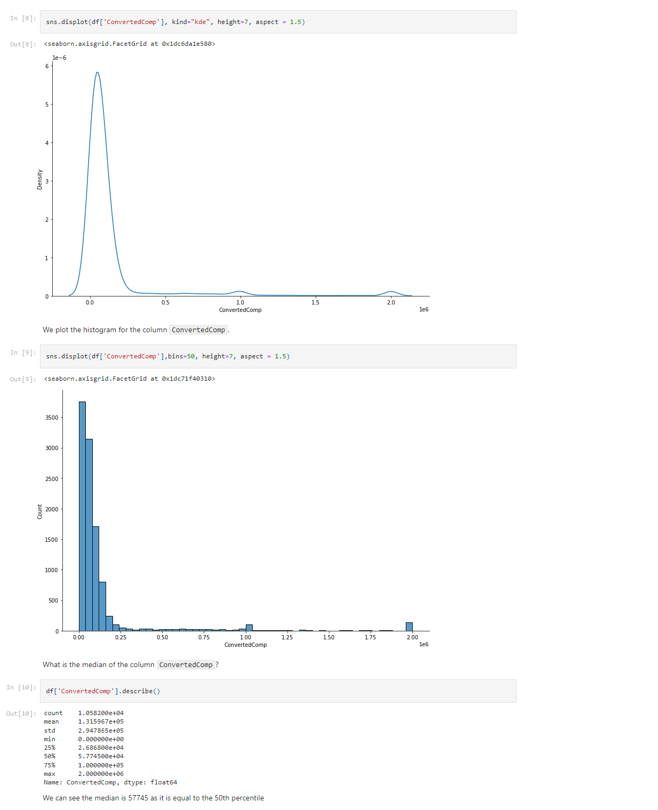
APPENDIX

Slide 20
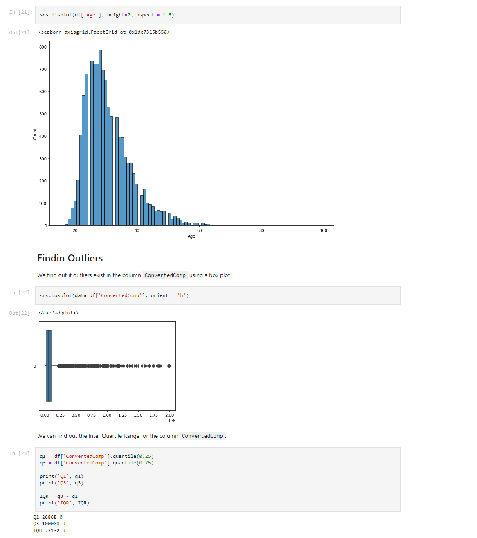
APPENDIX

Slide 21
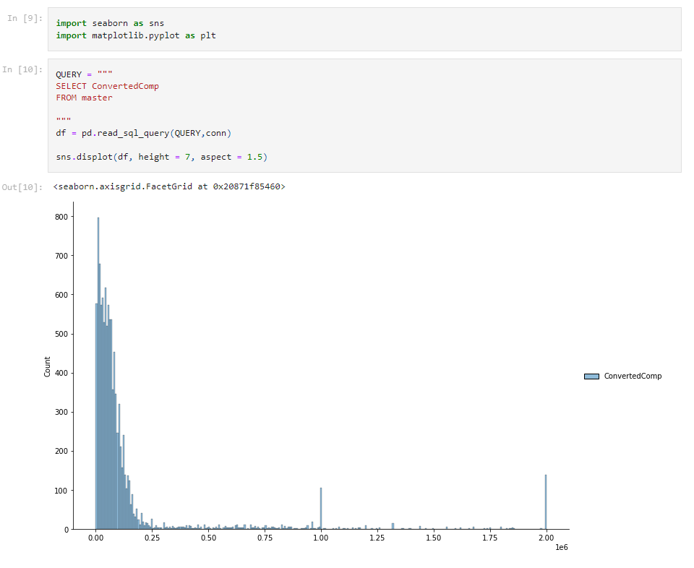
APPENDIX

Slide 22
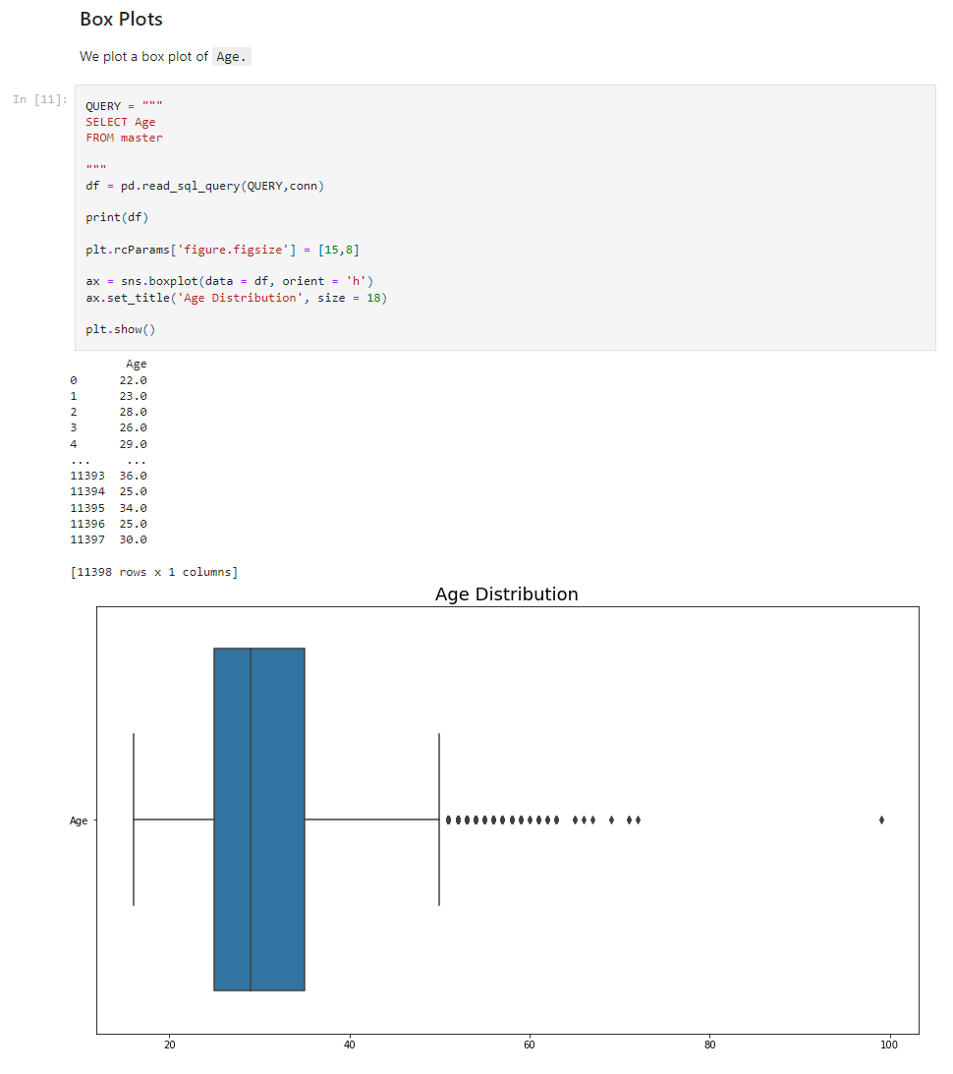
APPENDIX

Slide 23
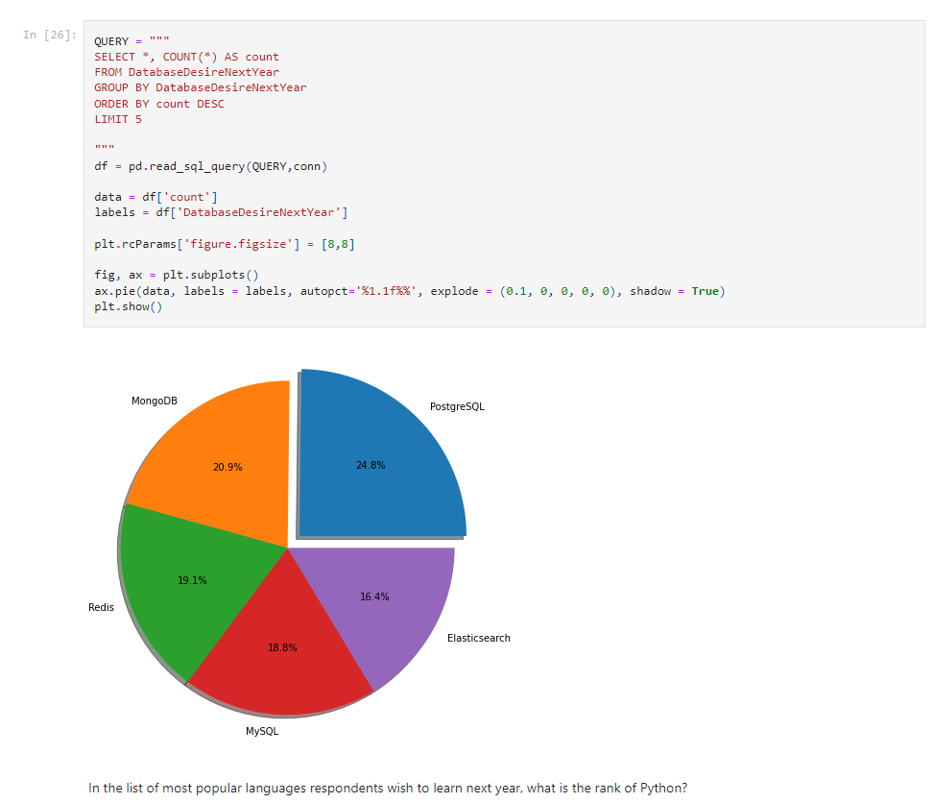
APPENDIX

Slide 24
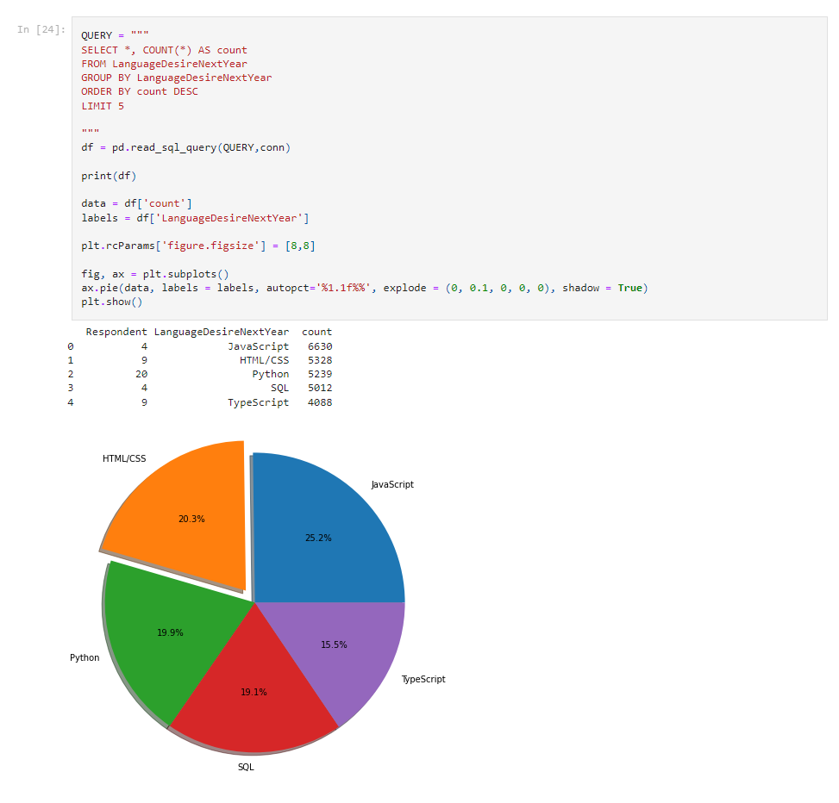
APPENDIX

Slide 25
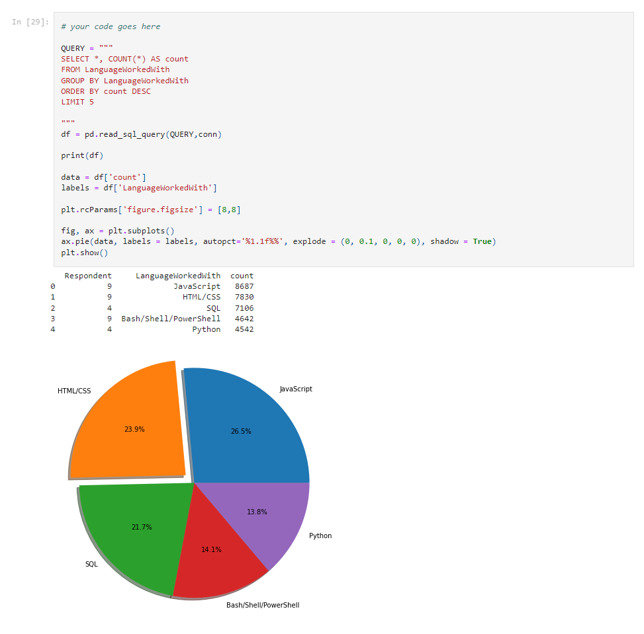
APPENDIX

Slide 26
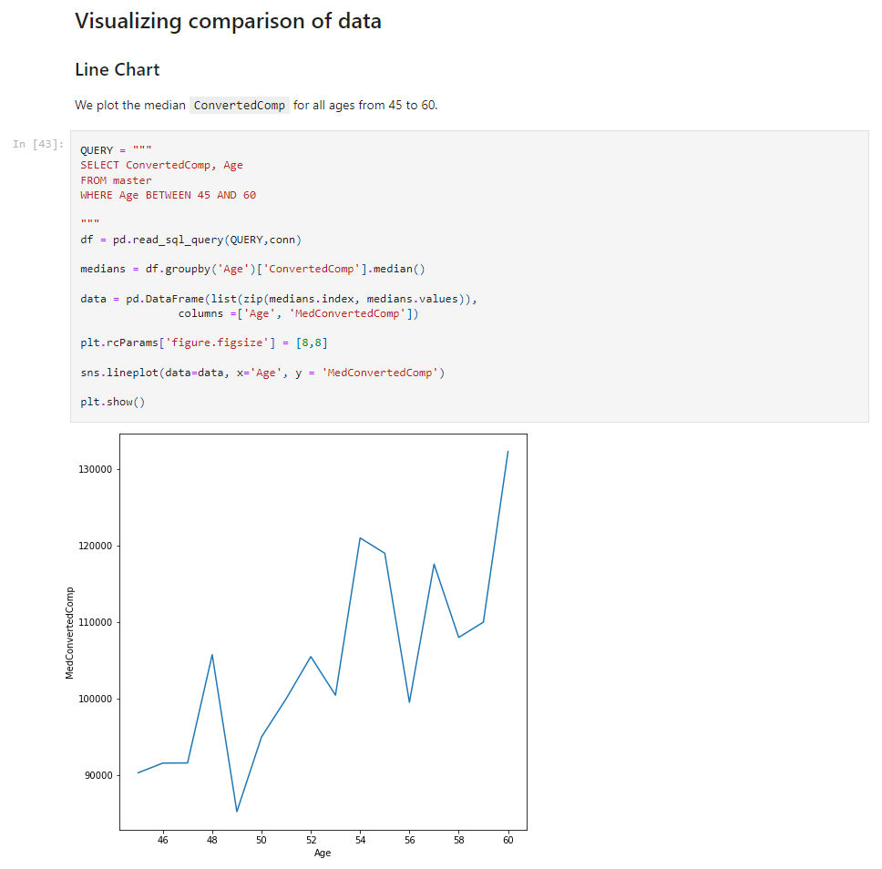
APPENDIX

